Slide 1
Public Service Announcement
Make sure you have registered for the course if you want to receive a grade!
System | FAU: StudOn / Moodle TUB: ISIS FUB: … | FAU: Campo TUB: MTS FUB: …
Purpose | Communication with professor | Registration to receive a grade
Content | Courses | Modules
Names | AMOS-PO AMOS-SD | 31441, 31451, … 31421, 31431, …

Slide 2
Agile Programming
Dirk Riehle, FAU Erlangen
AMOS B05
Licensed under CC BY 4.0 International

Slide 3
Agenda
Agile programming
Refactoring
Test-driven development
Code review
Build processes
Mid-project review

Slide 4
1. Agile Programming

Slide 5
Programming Principles
KISS (keep it simple, silly)
YAGNI (you ain’t gonna need it)
DRY (don’t repeat yourself)

Slide 6
How to Approach a Programming Problem
Make it run
Make it right
Make it fast

Slide 7
Agile Methods are Business-Value-Driven
In agile methods, software developers work off features
Features must have business value
Features can cut across runtime tiers and code layers
Agile programming is challenging and requires broad competencies

Slide 8
Collective vs. Individual Code Ownership
Collective code ownership
Everyone is equally responsible for the overall code base
Everyone is both allowed to and should be able to fix anything
Instills a feeling of overall responsibility, ensuring high quality
Individual code ownership
Individuals are responsible for their own code
Works best in a distributed setting, e.g. in open source
Agile programming assumes collective code ownership

Slide 9
Programming Standards (a.k.a Coding Guidelines)
A programming standard is a
Set of rules and conventions for naming, formatting, and structuring code
A standard makes it easier to read code written by other people
Nine times out of ten, code is read, not written
Programming standards should be mandatory

Slide 10
Professional Language [1]
Query methods | Mutation methods | Helper methods
Get method (getter) | Set method (setter) | Factory method
Boolean query methods | Command method | Cloning method
Comparison method | Initialization method | Assertion method
Conversion method | Finalization method | Logging method
… | … | …
[1] See our course on advanced design and programming (ADAP)

Slide 11
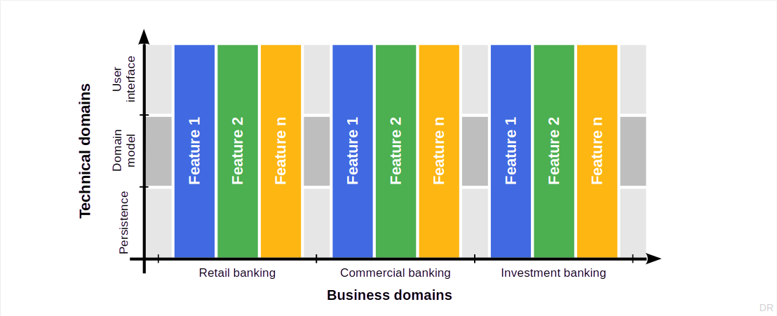
Feature Teams (Dealing With Complexity)

Slide 12
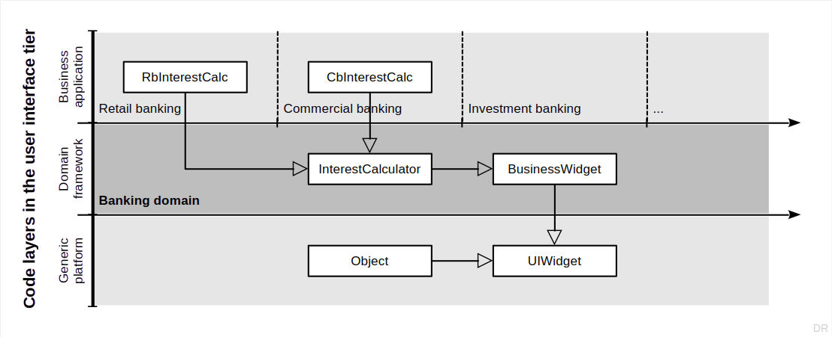
Inner-Source Software Development

Slide 13
2. Technical Debt

Slide 14

Ward Cunningham [1] on Technical Debt [2]
[1] See https://en.wikipedia.org/wiki/Ward_Cunningham
[2] See https://youtu.be/_NH_AIOsToo

Slide 15
Technical Debt
Technical debt is a
Lack of quality or comprehensiveness of code that
You accept to temporarily speed up development
Until you have to pay back the debt by refactoring
It is a metaphor used to communicate with managers

Slide 16
Managing Technical Debt
Identify the technical debt
By so called “code smells”
Determine the need to act
By correlating occurrences
Know how to pay back
By refactoring your code

Slide 17
Code Smells [1]
Code smells are
Identifiable structures in code that
Violate established design principles and
Reduce overall code quality
Code smells are not bugs (the code works, it just … smells)
[1] Fowler, M. (1999). Refactoring. Addison-Wesley Professional.

Slide 18
Example Code Smells
Duplicate code
Long method
Large class
…

Slide 19
The “Three Strikes” Rule
First time: Just do it
Second time: Wince at duplication
Third time: Refactor

Slide 20
Refactoring
A refactoring is a
Behavior-preserving transformation of code (with the goal of improving it)

Slide 21
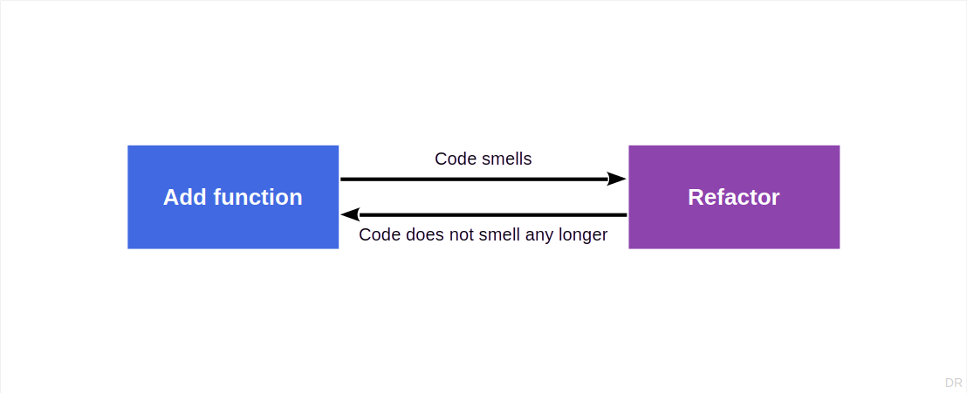
Refactoring Process (“Two Hats”)

Slide 22
Example Refactorings
Extract method
Pull up field
Form template method
Decompose conditional
Extract class
Extract subclass
Extract interface
…

Slide 23
Example Smell Removal by Refactoring
Remove Duplicated Code by Extract Method or Pull Up Field or …
Remove Long Method by Extract Method or Decompose Conditional or …
Remove Large Class by Extract Class or Extract Subclass or …

Slide 24
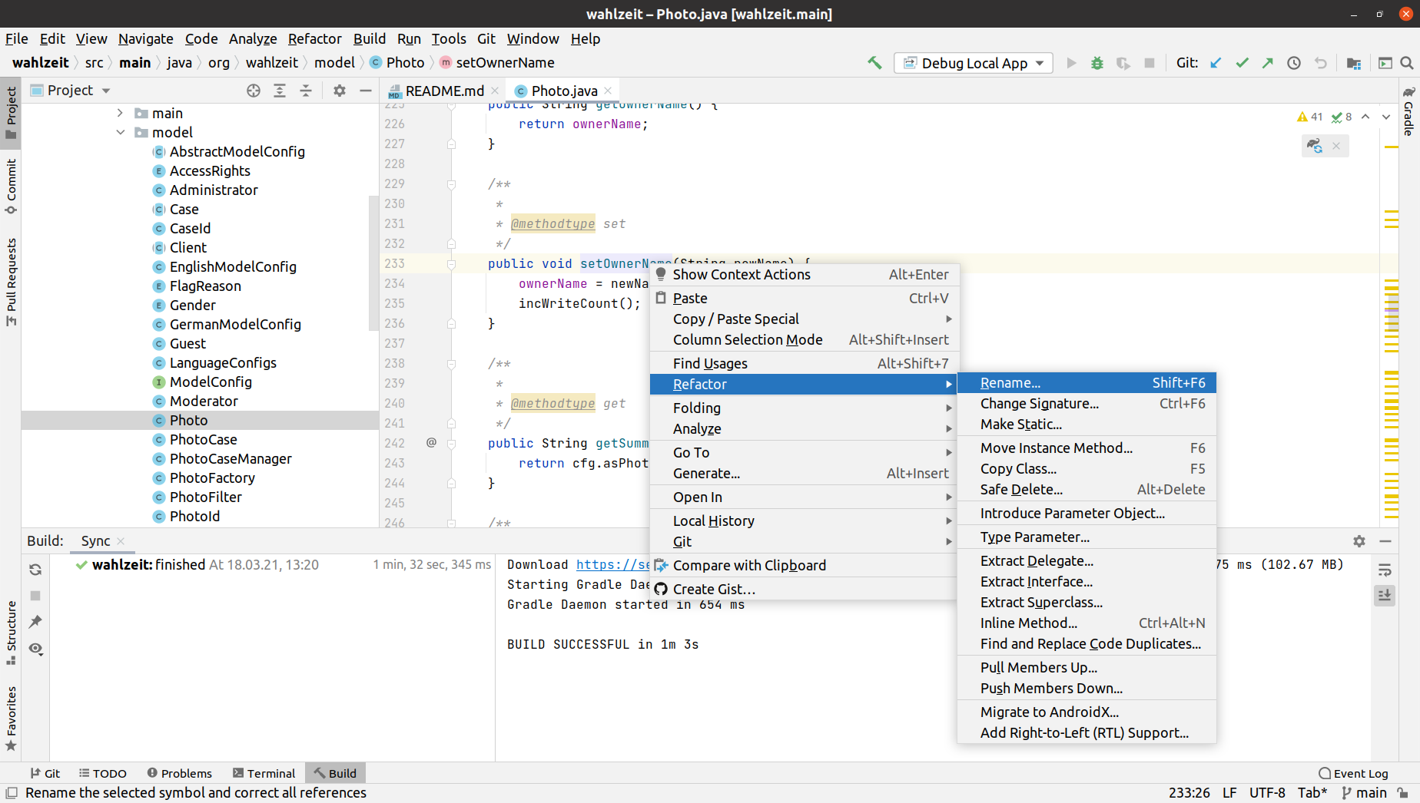
IDEs Readily Support (Some) Refactorings

Slide 25
3. Test-Driven Development

Slide 26
Test Terminology
Testing is a process for assessing correct operation according to a specification
A test is the instructions to perform a specific assessment
Component tests (unit tests) test a particular component in isolation
Acceptance tests (functional tests) test a cross-cutting function
Integration tests (end-to-end tests) test the interaction of several components
Tests can be automated or manually performed

Slide 27
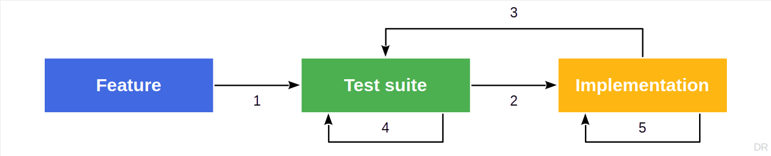
Test-First Programming
Test-first programming is the
Practice of first writing a test and then making the system pass the test

Slide 28
Rules of Test-first Programming
Only write new code if a test fails, then eliminate waste
Red, green, refactor

Slide 29
Test-Driven Development
Test-driven development is a
Minimal development process based on test-first programming

Slide 30
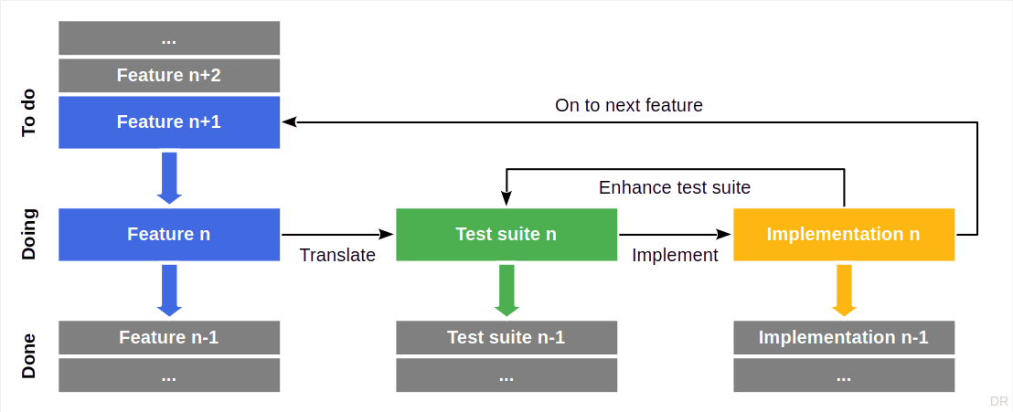
Test-Driven Development Process

Slide 31
4. Code Review

Slide 32
Code Review
Code review is the practice of
Having someone else assess your code for feedback and approval
More formally, a code review is
The systematic examination [...] of computer source code
Common forms of code review are
Pair programming
Walkthroughs
Inspections

Slide 33
When to Perform Code Reviews
As code is written (→ Pair programming)
Before a commit (→ Pre-commit code review)
Before a release
At some other time

Slide 34
Pair Programming
Pair programming is the practice of
Two people in front of the same display, with
One person implementing, i.e. writing code (acting in the moment), and
One person reviewing, i.e. watching, thinking, commenting, steering
These are the programmer and the reviewer, also
Driver and co-driver
Pilot and navigator

Slide 35
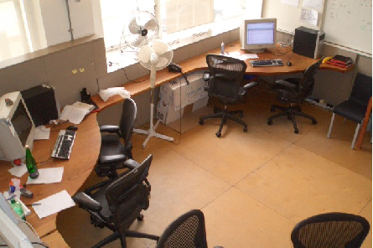

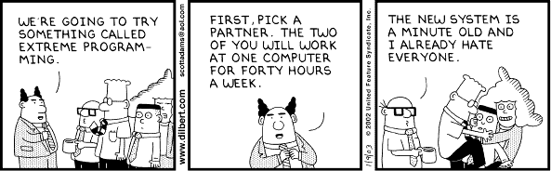
Advice on Pair Programming
Find comfortable partner
Switch roles regularly
Communicate regularly
Don’t force it for small stuff
Don’t overheat, take breaks
Switch partners at times

Slide 36
Pre-Commit Code Review
Pre-commit code review is the practice of
Having a peer review code for feedback and approval before it gets committed
The benefits of pre-commit code review
Strengthens feeling of collective responsibility
Improves knowledge sharing and teamwork
Catches bugs and problems at the right time
Leads to more disciplined developers
Raises overall quality cost-efficiently
Made easy through distributed version control and merge requests

Slide 37
Source Code Traceability
Traceability of something is the
Ability to trace the something back to its roots / predecessors
Traceability of source code (a.k.a. post-RS traceability) is the
Ability to trace back the source code to the requirement it fulfills
Realized on GitHub by linking pull requests to their issue
Benefits of source code traceability
Makes clear why the code is there in the first place
Helps fulfill standards and certification requirements
Ensures commits are focused / semantically closed

Slide 38
5. Build Processes

Slide 39
Build Process
A build process is the process of
Creating an installable software from its source artifacts
Quality criteria of a build process are
Fully automated
Reentrant and deterministic
With a defined context independent environment
All build assets need to be managed properly

Slide 40
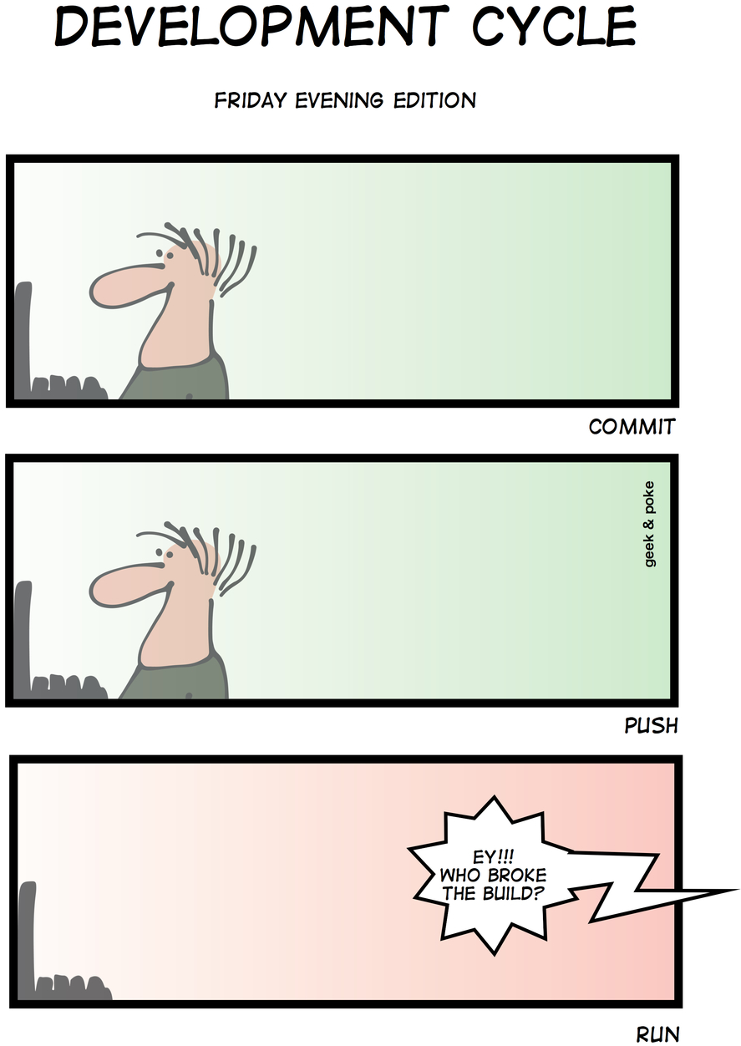
Developer Responsibilities
Don’t break the build (where it affects others)
Only commit code that compiles
Only commit code that passes all tests
Only work in a standardized work environment

Slide 41
Continuous Integration
Continuous integration is the practice of
Automatically building and testing the software upon defined triggers
Usually with every commit of a developer
Sometimes only once per day (nightly builds)
Continuous integration may have different scopes
Depending on the size of the software under development
The goal is to always know whether the software is in good working order
The faster you can react to an issue, the better (more cost-efficient)

Slide 42
Continuous Deployment
Continuous deployment is the practice of not only building and testing but of
Deploying the software into production
Users are the final deciders of
Whether the software does what is expect of it
Continuous deployment requires monitoring the performance of the software
Beyond system tests, you need to watch key metrics of performance

Slide 43
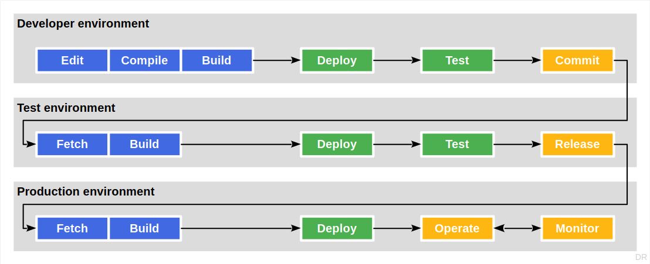
Separation of Environments

Slide 44
One-time Deliverable: Build Process Video
Please create a recorded from-scratch demonstration of your full build process
If you run a continuous integration process, great! But it is not required

Slide 45
6. Mid-Project Review

Slide 46
Milestone: Mid-Project Review
We expect you to demo your work
One command to start the software for demoing purposes
Have a script for the most common use-case and demo it
We will call arbitrarily on people in the team to show this
Feel free to coordinate with and learn from other teams

Slide 47
Summary
Agile programming
Refactoring
Test-driven development
Code review
Build processes
Mid-project review

Slide 48
Thank you! Any questions?
dirk.riehle@fau.de – https://oss.cs.fau.de
dirk@riehle.org – https://dirkriehle.com – @dirkriehle

Slide 49
Legal Notices
License
Licensed under the CC BY 4.0 International license
Copyright
© Copyright 2009-2025 Dirk Riehle, some rights reserved

